Slide 1
Financial Highlights
As of December 31, 2023
One Minute Report – Click Below

Slide 2
Highlights of Interim Financial Report (unaudited)
December 31, 2023

Slide 3
Posted on Our Website
Finance / Monthly Finance Reports (hcde-texas.org)
Linked from State Comptroller’s website
http://www.texastransparency.org/local/schools.php

Slide 4
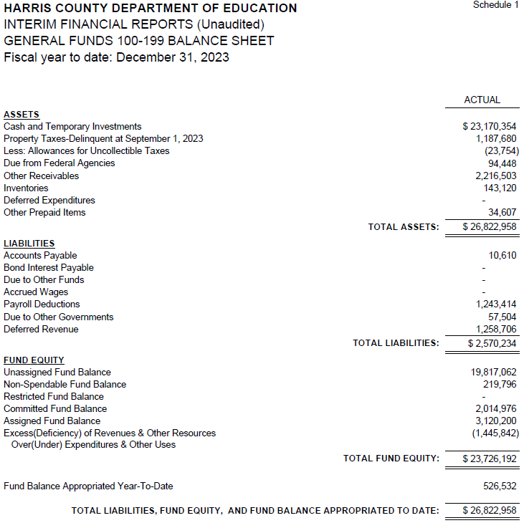
INTERIM FINANCIAL REPORT (unaudited) GENERAL FUND
Balance Sheet as of December 31, 2023
Total Assets:
$ 26,822,958
Total Liabilities:
$ 2,570,234
Total Fund Equity:
$ 23,726,192

Slide 5
INTERIM FINANCIAL REPORT (unaudited) ASST. SUPERINTENDENT FOR BUSINESS SERVICES MESSAGE As of December 31, 2023
The ESTIMATED General Fund balance at 12/31/2023 is $23,726,192 after current appropriations.
As year end adjustments are completed, a budget amendment will be submitted to the board for items assigned, restricted and committed that will roll forward into FY 2024.

Slide 6
INTERIM FINANCIAL REPORT (unaudited) As of December 31, 2023 Financial Ratios
Level One - Indicator of Financial Strength
Level Two - Indicator of Efficient Leverage
Level Three - Indicators of Efficiency
Level Four - Indicators of Revenue Growth

Slide 7
Three months
INTERIM FINANCIAL REPORT (unaudited) As of December 31, 2023 Indicators of Financial Strength
SEPT | OCT | NOV | DEC
4.5 months without Tax Revenue
Percent of Fund Balance to G/F
Expenditures Ratio
What is the percent of rainy-day fund balance?
(*) Unadjusted
Working Capital Ratio
What is the cash flow availability for the organization?
Unassigned Fund Balance $ 19,817,062
Total G/F Expenditures $ 19,343,209
Goal : > 30% of G/F Exp.
Benchmark: 10% to 29%
Danger: Under 10%
Goal : >$15,000,000
Benchmark : $10M to $15M
Danger : Under < $10M
Total Current Assets
Less Total Current Liabilities
$26,822,957 - 2,570,234 = $24,252,724
102% FY24
102% FY23
$24M FY24
$25M FY23
Budgeted 24%
Details on Schedule 3
Budgeted $33M
Details on Schedule 1

Slide 8
INTERIM FINANCIAL REPORT (unaudited) As of December 31, 2023 Indicators of Efficient Leverage Reserves
Budgeted Payments $3.8M
Current $2.9M
Unassigned Fund Balance Ratio
How much is available in reserves?
Debt to Income Ratio
What is the ability of HCDE to cover
its debt payments?
Unassigned Fund Balance $19,817,062
Total Fund Balance $24,252,724
Annual Principal and Interest Payments on
Term Debt and Capital Leases : $0
G/F Revenue Less Facility $17,897,367–2,734,527
Charges :
Goal: <75%
Benchmark: 50% to 75%
Danger: <50%
Goal: <25% of annual revenue
Benchmark: 25% to <49%
Danger: Over > 50%
82% FY24
66% FY23
0% FY24
0% FY23
Budgeted 71%
Details on Schedule 1
Budgeted 6%
Details on Schedule 5

Slide 9
INTERIM FINANCIAL REPORT (unaudited) As of December 31, 2023 Indicators of Efficiency
Tax Revenue to Total Revenue Ratio
How efficient is HCDE at leveraging local
taxes? (Current)
Indirect Cost to Tax Ratio
How much dependency on indirect cost from grants?
Current Tax Revenue $ 4,131,661
Indirect Cost General Fund $578,837
Total Revenue $ 31,554,595
Total General Fund Revenues $17,897,368
Total General Fund Revenues $1,306,381
Goal: <20% of revenue
Benchmark: 20% to 30%
Danger: Over >30%
Goal: >5%
Benchmark: 2% to 5%
Danger: Under < 2%
Goal: >5%
Benchmark: 2% to 5%
Danger: Under < 2%
13% FY24
24% FY23
3.2% FY24
3.4% FY23
Budgeted 25%
Details on Schedule 2
Budgeted 2.5%
Details on Schedule 3

Slide 10
INTERIM FINANCIAL REPORT (unaudited) As of December 31, 2023 Indicators of Revenue Growth
Fee for Service Revenue Ratio
How are revenues spread across all Funds?
Fee for Service Revenue Growth Ratio
What is the market growth for fee on services?
Total Fee for Service Revenues (G/F) $9,740,294
Total Revenues $31,554,595
Fee for Service Current Year Less Fee for Services Last Year $9,740,294 – 7,360,308
Fees for Service Last Year $7,360,308
Goal: >30% of annual revenue Benchmark: 10% to 29%
Danger: Under 10%
Goal: >3% of + growth
Benchmark: 0% to 3%
Danger: Under 0%
31% FY24
27.5% FY23
32% FY24
26% FY23 ​
Budgeted 19%
Details on Schedule 14
Budgeted 17%
Details on Schedule 14

Slide 11
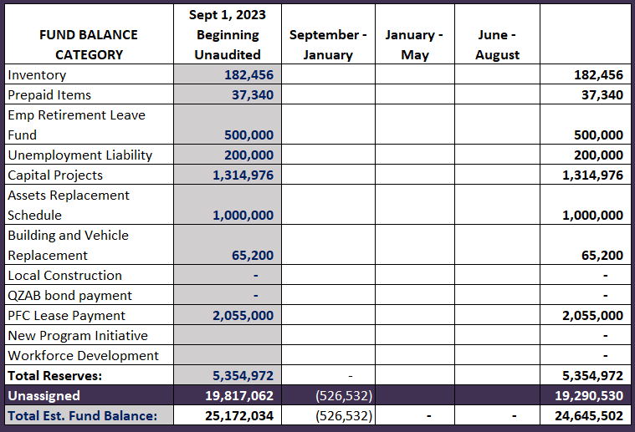
FY 2023-2024 Fund Balance - Budgeted Activity

Slide 12
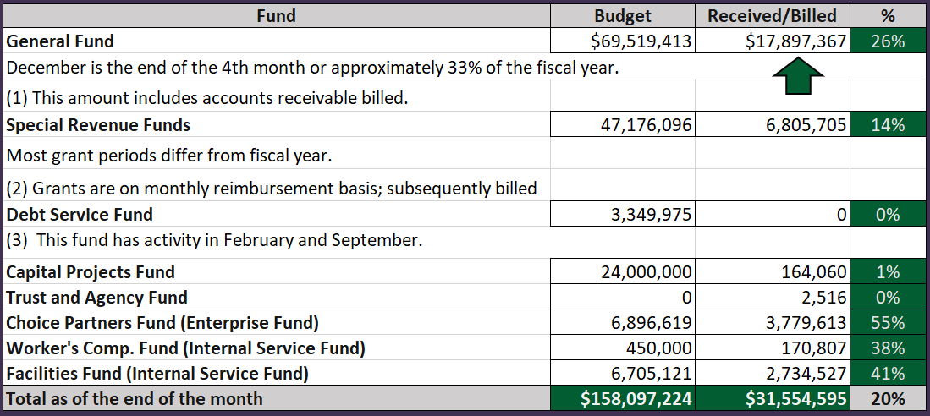
INTERIM FINANCIAL REPORT (unaudited) GENERAL, SPECIAL REVENUE, DEBT SERVICE FUNDS, CAPITAL PROJECTS,
AND INTERNAL SERVICE FUNDS
REVENUES (INFLOWS)
Budget to Actual for period ending December 31, 2023

Slide 13
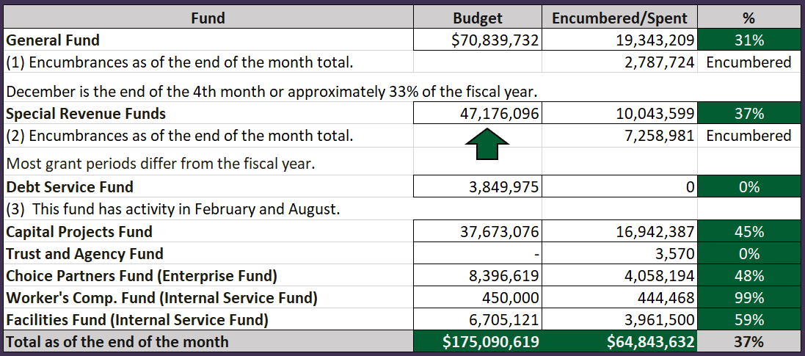
INTERIM FINANCIAL REPORT (unaudited)
GENERAL, SPECIAL REVENUE, DEBT SERVICE FUNDS, CAPITAL PROJECTS,
AND INTERNAL SERVICE FUNDS Expenditures (OUTFLOWS)
Budget to Actual for period ending December 31, 2023

Slide 14
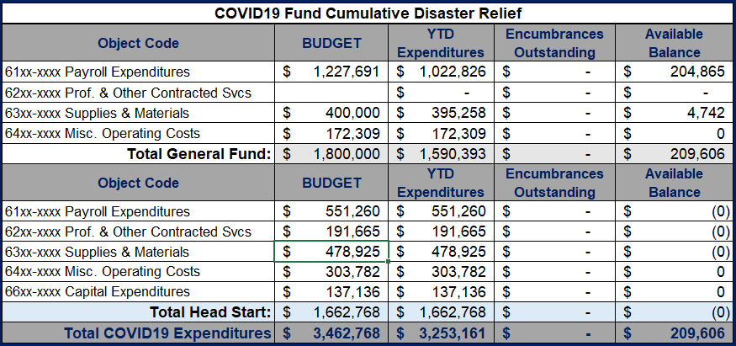
INTERIM FINANCIAL REPORT (unaudited) FY 2021 – 24 COVID19 Budget to Actual – Expenditures
for period ending December 31, 2023
Head Start grants ended by August 31st, 2023. All funds were drawdown and final reports will be submitted.
All HCDE covid funds are committed for the current fiscal year

Slide 15
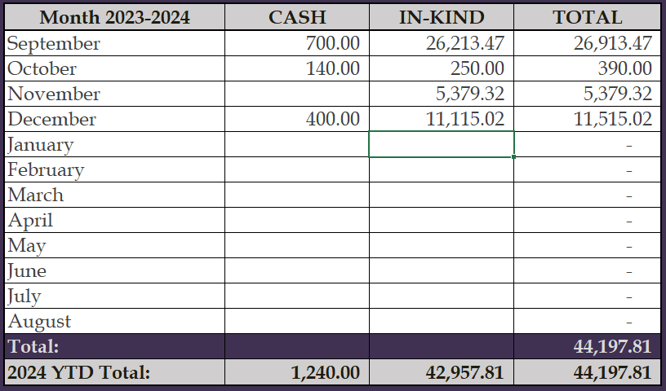
INTERIM FINANCIAL REPORT (unaudited) FY 2023-24 Donations Report All Funds as of December 31, 2023

Slide 16
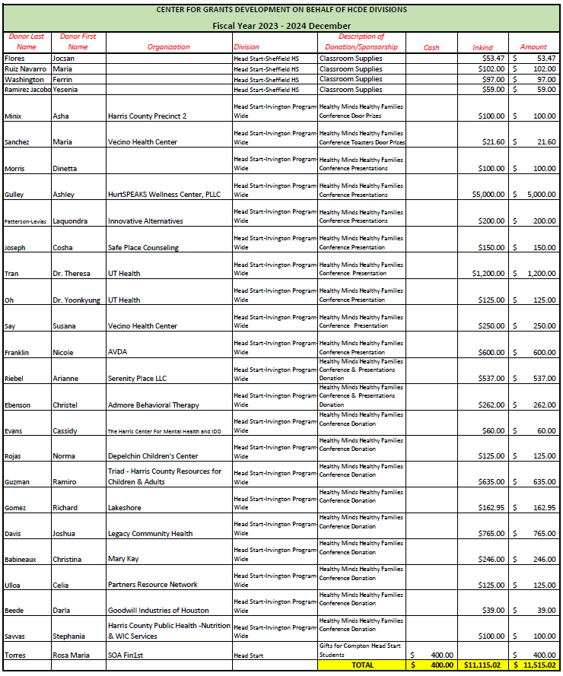
`
INTERIM FINANCIAL REPORT (unaudited) FY 2023-24 Donations Report All Funds as of December 31, 2023

Slide 17
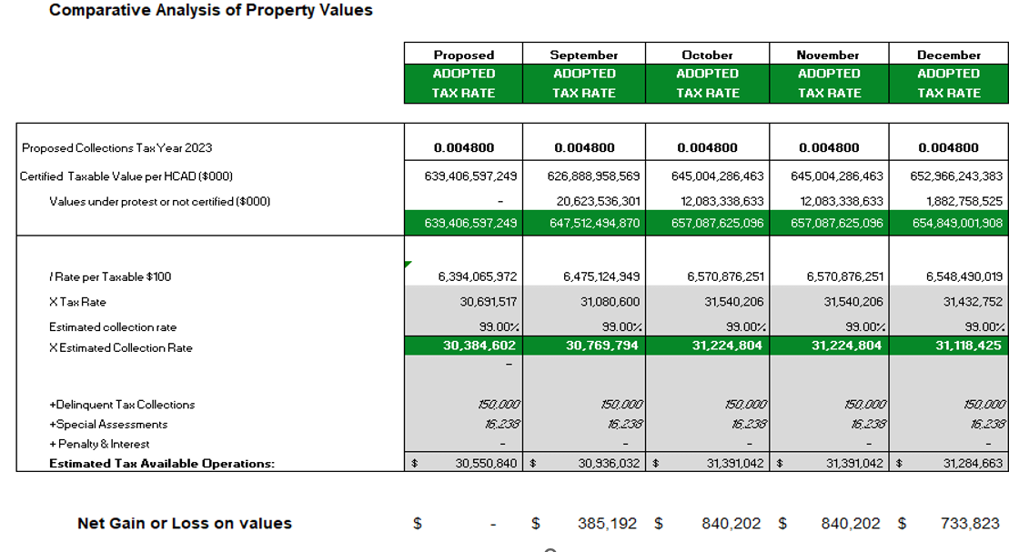
INTERIM FINANCIAL REPORT (unaudited) TAX COLLECTIONS COMPARATIVE ANALYSIS Fiscal Year-To-Date as of December 31, 2023
652.97 B
See Tax Calculator at:
https://hcde-texas.org/transparency/tax-rate/
17

Slide 18
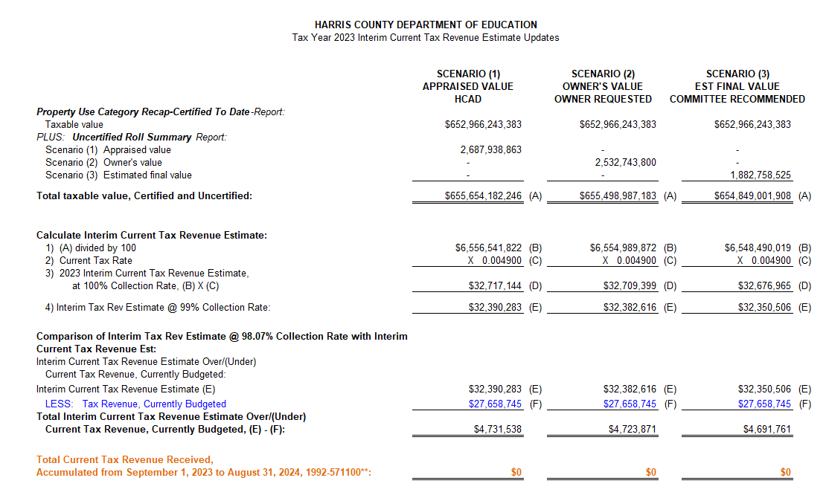
INTERIM FINANCIAL REPORT (unaudited) TAX COLLECTIONS
Fiscal Year-To-Date as of December 31, 2023
(4th month / 12 months)

Slide 19
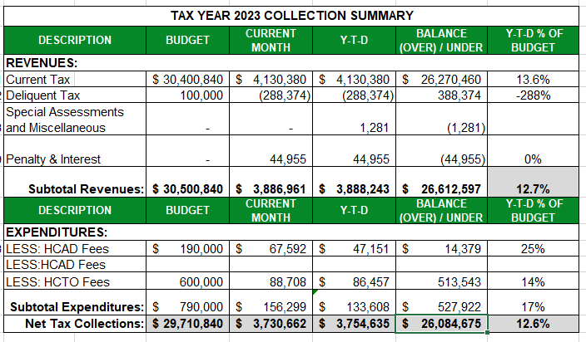
INTERIM FINANCIAL REPORT (unaudited) TAX COLLECTIONS
Fiscal Year-To-Date as of December 31, 2023
(4th month / 12 months)
a) 2023 Proposed Tax Rate = $0.004800/$100 Property Assessment/Appraisal - --> Annual Tax on a $259,375 - $75,219 = $201,066/100
x .004800 = $9.65 (net of 29% homestead exception.)
b) $705,000/$30,500,840 = 2.32% Collection and assessment costs

Slide 20
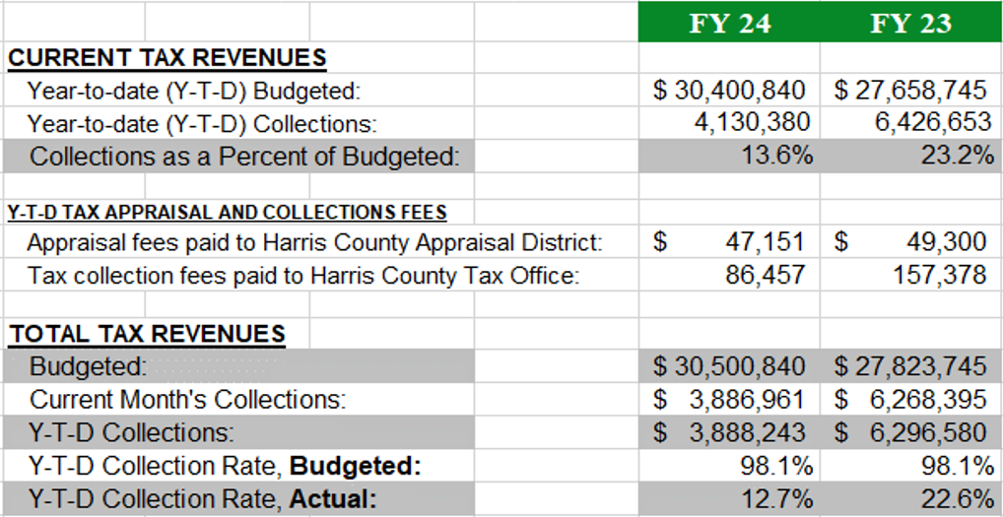
INTERIM FINANCIAL REPORT (unaudited) TAX COLLECTIONS
Fiscal Year-To-Date as of December 31, 2023
(4th month / 12 months)
2022 Adopted Tax Rate = $0.004900/$100 Property Assessment/Appraisal - --> Annual Tax on a $259,375 - $75,219 = $201,066/100 x .004900 = $9.85 (net of 29% homestead exception.)
b) $705,000/$25,188,000 = 2.80% Collection and assessment costs

Slide 21
INTERIM FINANCIAL REPORT (unaudited) DISBURSEMENT – ALL FUNDS December 31, 2023
Notes:
All Purchase Orders and Payment Authorizations are reviewed before disbursement.
All Procurement Card charges are reviewed by cardholder, supervisor, and business office staff each month.
A report on CH Local Expenditures is included in the monthly report.

Slide 22
INTERIM FINANCIAL REPORT (unaudited) Segment Division Data As of December 31, 2023

Slide 23
HIGHLIGHTS OF BUDGET AMENDMENT REPORT January 17th Board Meeting (unaudited)
Amendments
No Budget Amendments for the month of January
Amendment proposed for February for maintenance notes for the construction projects.

Slide 24
Education Foundation Update
December 31, 2023

Slide 25
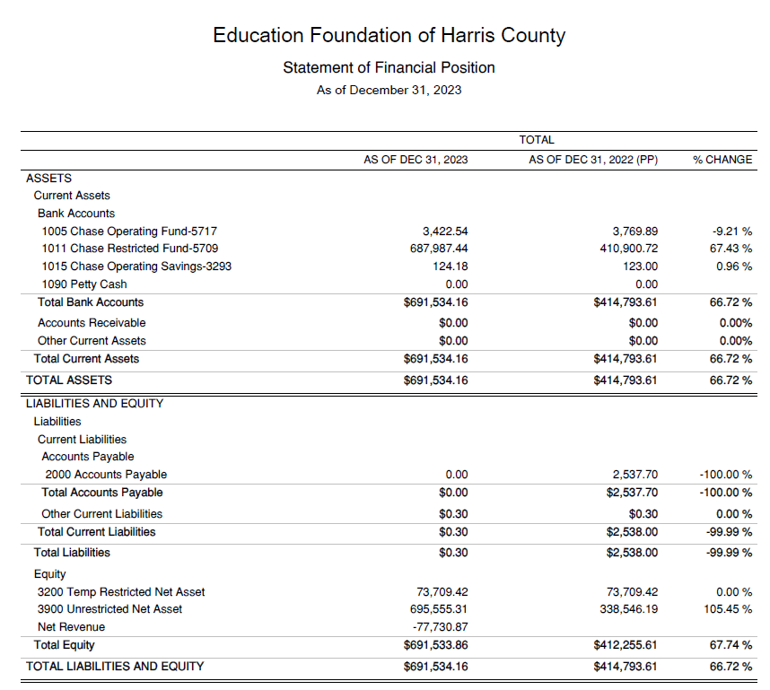
Statement of Financial Position
Net Equity $691,534

Slide 26
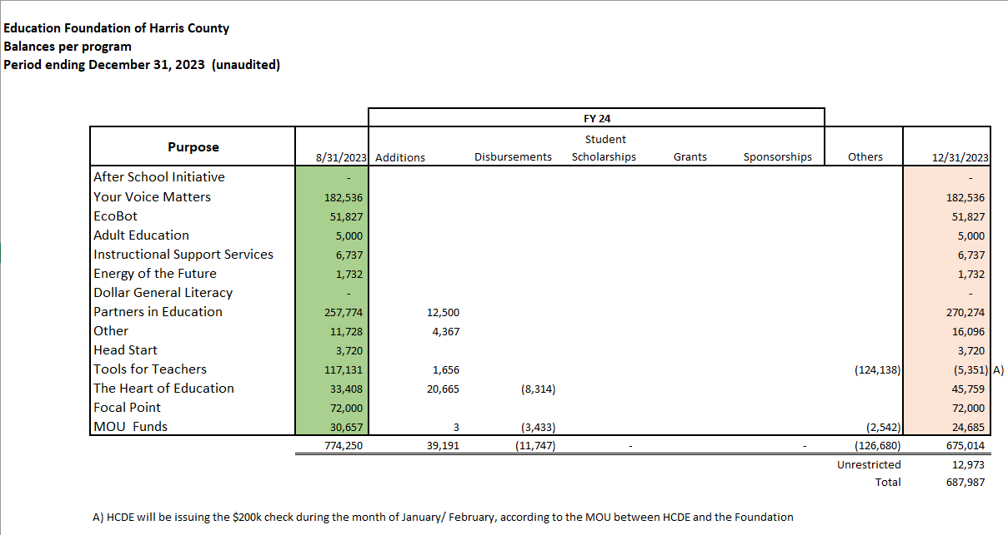
Balances Per Program

Slide 27
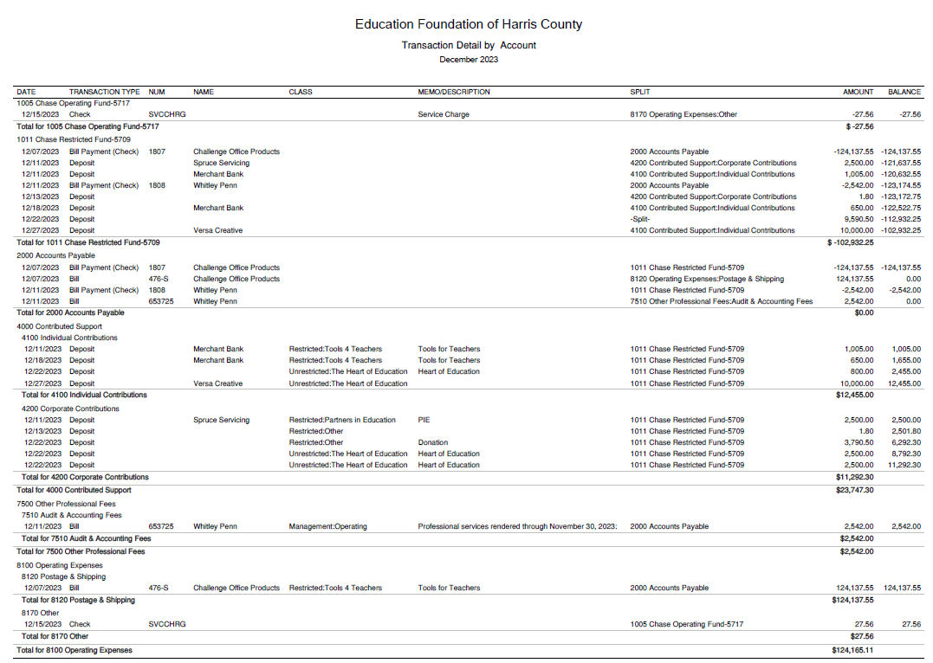
Transaction Detail by Inflow & Outflow

Slide 28
PFC & Lease Revenue Projects Update
December 31, 2023

Slide 29
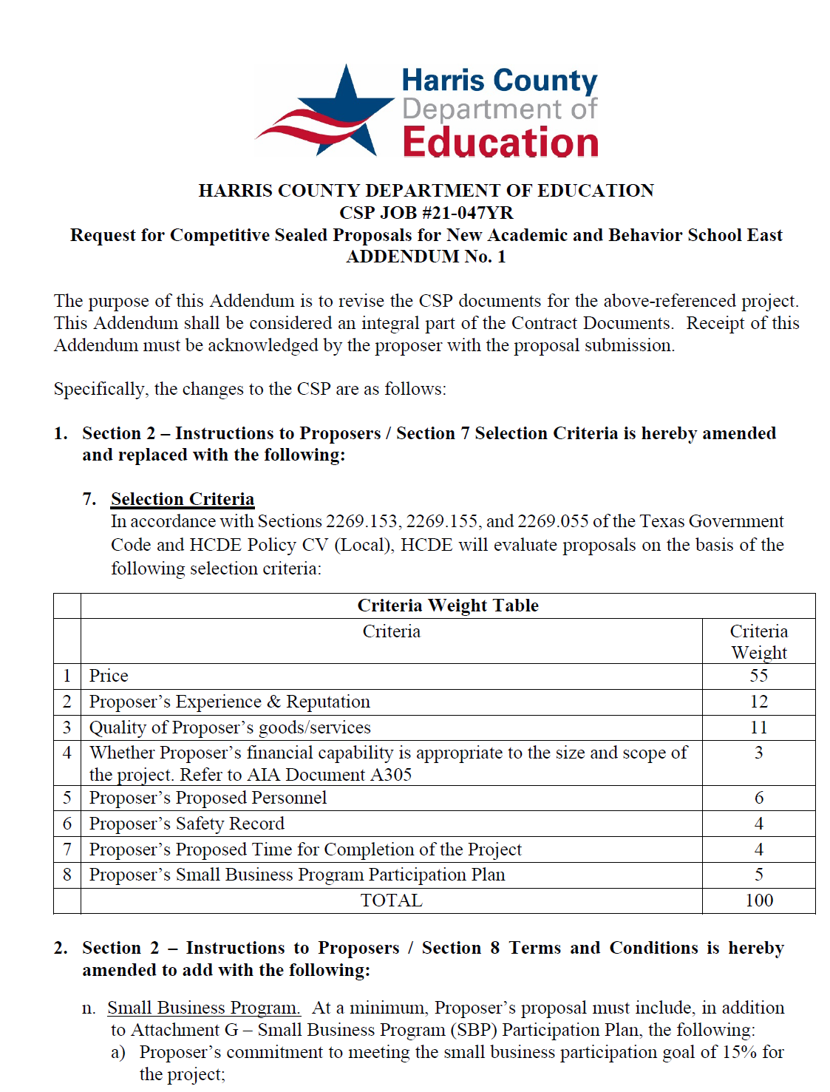
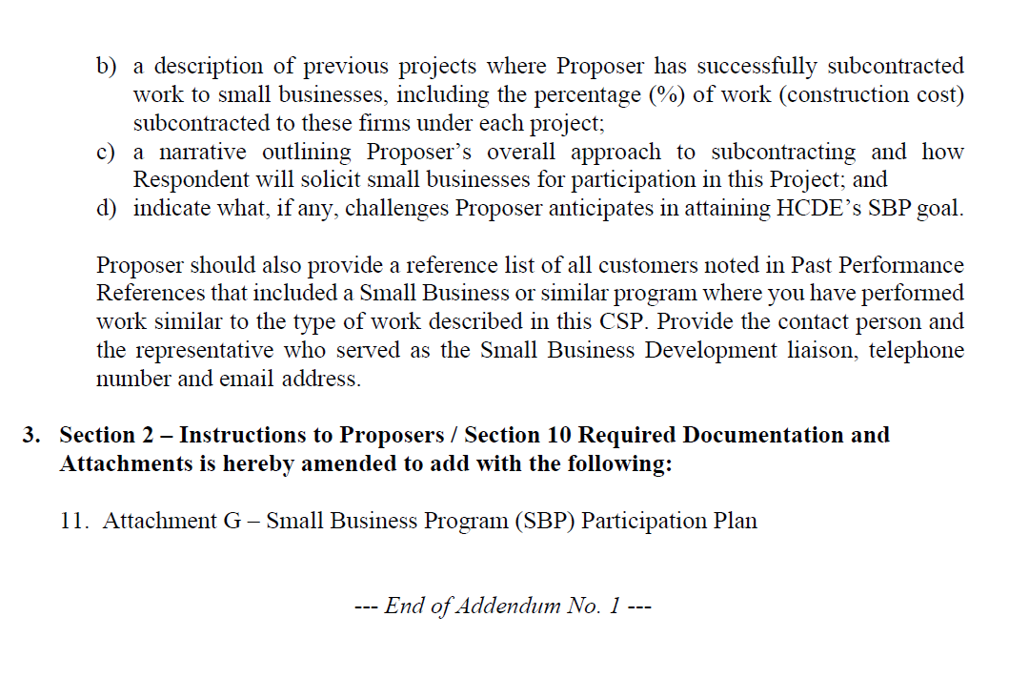
Small Business Program for construction
Launch industry's first collaboration feature
This is our plan as we launch the industry's first collaboration feature

Slide 30
Small Business Program for construction
Target 15%
AB East
Contract Amt $12,348,500
SBP Amt $1,879,557
Adult Ed Center
Contract Amt $14,123,065
SBP Amt $6,051,690
Percent achieved 15.2%
Hp East
Contract Amt $7,705,147
Percent Achieved 42.85%
SBP Amt $4,029,198
Percent Achieved 52.29%

Slide 31
Small Business Program for 2023 Expenditures
Attached is the Detailed report.

Slide 32
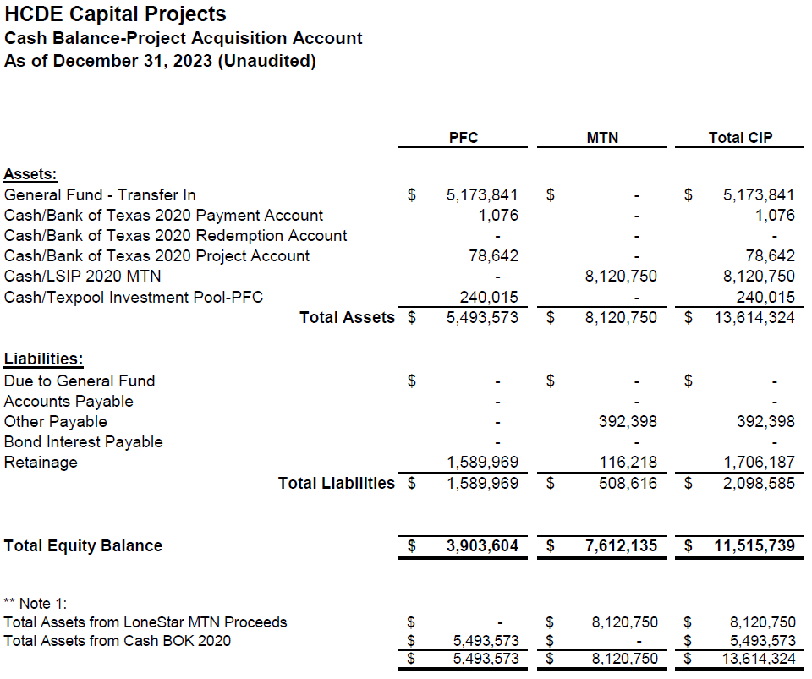
AB East School Contract $12,358,000 Awarded and Signed
Adult Ed Center Contract $15,121,000 awarded on Oct 2021 Board Mtg
HP East Contract $7,271,000 awarded on Nov 2021
Irvington – Pending Architect Assignment
Cash Balance –
Project Acquisition Account
As of December 31, 2023

Slide 33
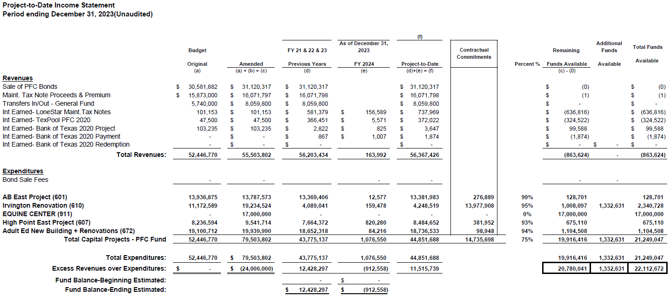
Income Statement– Project Acquisition Account
As of December 31, 2023

Slide 34
Irvington Renovation – Funds by Source
As of December 31, 2023
34

Slide 35
2020 Projected Capital Improvement Program
Project | Substantial Completion Date | Project Budget | Maintenance Notes Projected | Revenue Bonds Proceeds | General Funds Use of Fund Bal. | Interest Earnings Projection
Reagan Adm Bldg. | Feb 9, 2023 | $8,365,500 | $ 8,365,500 | N/A | N/A
Adult Ed Building | Oct 25, 2022 | $18,358,750 | $ 3,659,000 | $12,728,598 | $1,870,000 | $101,153
HP East Middle | Oct 25, 2022 | $7,916,645 | $ 1,089,500 | $4,909,645 | $1,870,000 | $47,500
Ab East Campus | Aug 16, 2022 | $17,805,875 | $ 2,759,000 | $12,943,640 | $2,000,000 | 103,235
 | Total | $52,446,770 | $15,873,000 | $30,581,882 | $5,740,000 | $251,888
 |  | Closed on 12-2-20 | Invested in pools.
Build a product accessible on all devices
This is our plan as we build a product accessible on all devices.
Note: The Total Public Notice was $54,000,000. ($35,000,000 for Revenue bonds and $19,000,000 for Maintenance Notes) on August 10, 2020. A transfer of $1,350,000 plus $50,000 in reimbursable expenditures was made from AB East to allocate Program Manager costs to establish the budgets.
Based on Pricing the principal amount will vary due to the premium projected in the bond sale. Revenues Bonds estimated at $27,730,000 and Maintenance Notes for $13,695,000

Slide 36
2024 Projected Capital Improvement Program Phase 2
Project | Description | Project Budget | Maintenance Notes Projected | Revenue Bonds Proceeds | General Funds Use of Fund Bal. | Interest Earnings Projection
Reagan Adm Bldg. | Additional Funds Needed | $6,000,000 | $ 6,000,000 | N/A | N/A | N/A
Roof/HVAC Systems | Barrett Station Deck, Crosstimbers, AB West | $963,000 | $963,000
Roof Systems | NPO Westview, Fortis, Conference Ctr | $7,350,000 | $7,350,000
Furniture-Equipment Irvington | Irvington | $1,000,000 | $1,000,000
IT Infrastructure- servers | Servers, infrastructure | $1,000,000 | $1,000,000 |  |  | $500,000
 | Total for 2024 | $16,133,000 | $16,133,000 | $0 | $0
 |  |  |  |  |  | $500,000
Equine Center Pending 2025 | Projected for 2025 |  |  | $15,000,000 |  | $500,000
Build a product accessible on all devices
This is our plan as we build a product accessible on all devices.

Slide 37
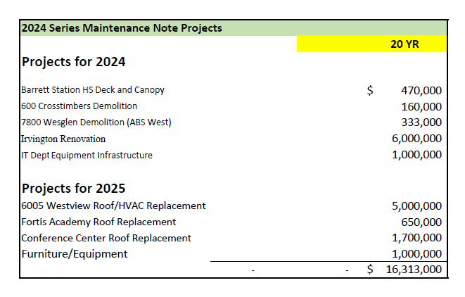

Slide 38
Dec 2023 Maintenance Note Plan
Jan 2024 Audit Report and POS Prep
January 2024 Maintenance Note Rating
February 2024 – Maintenance Note Sale
March 2024 Maint. Note Closing
Project and Budget Implementation

Slide 39
Financing Team Members:
HCDE - Harris County Department of Education
FA - Financial Advisor – USCA Municipal Advisors LLC
BC - Bond Counsel – Orrick, Herrington & Sutcliffe LLP
U - Underwriter – RBC Capital Markets
UC - Underwriter’s Counsel – Holland & Knight LLP

Slide 40
Interim Financial Report (Unaudited)
I certify that the foregoing information is true and accurate to the best of my knowledge.
/s/ Jesus J. Amezcua, RTSBA,CPA, Ph.D., CPFIM, Asst. Supt. for Business Support Services
/s/ Marcia Leiva, Chief Accounting Officer

